Slide 1

AYESHA ZAFAR – F24CSC015 DANIYAL ALI - F24CSC019 MAYUR SHAHANI - F24CSC031 MUHAMMAD AARAAF - F24CSC039 NASIR HUSSAIN - F24CSC020
INTRODUCTION TO MANAGEMENT
“VISIT TO BYTECORP SOFTWARE”
Group Members:
Computer Networks
Department of Computer Science
Faculty of Information and Technology
Faculty Name:
Sir Fahad Anwar

Slide 2
Introduction
Objective of the Visit
Understand real-life applications of management principles.
Observe BYTECORP’s team structure, hiring, and project planning processes.
Core Focus Bridging classroom theory with real business practices.
Learning Outcome Visit provided practical insights aligned with management concepts.

Slide 3
Management Processes – Marketing
Hybrid Marketing Strategy
Integrates both in-person and online outreach.
Balances traditional relationship-building with modern digital tools.
🔹 Use of Digital Platforms
Fiverr & Upwork used as active digital storefronts to attract global clients.
PPC campaigns boost visibility and drive targeted traffic.
Webinars and social media (LinkedIn, Instagram) used to showcase expertise and engage audiences.
🔹 Sales Fieldwork Approach
Sales team visits clients for product demos and consultations.
Emphasis on understanding client needs through face-to-face interaction.
🔹 Personal Touch in Tech
Marketing isn’t just selling — it’s storytelling.
BYTECORP emphasizes authentic, humanized communication over robotic promotion.

Slide 4
Management Processes – Hiring
Internal Hiring First:
Preference given to in-house talent before external hiring
External Platforms Used:
Forums, freelancing/job sites when in-house options don’t match
Interview Process (3 – 4 Rounds):
Includes a technical test to assess skills like architecture and scalability
Focus Areas:
Strong theoretical knowledge
Human-written code (no AI assistance)
Behavioural & Psychological Evaluation:
Assesses team fit, mindset, emotional intelligence

Slide 5
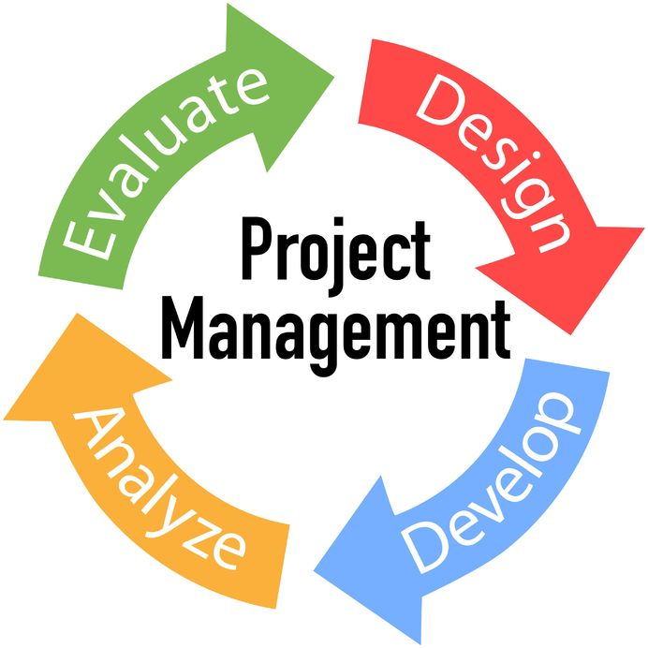
Project Planning & Lifecycle
Step-by-Step Lifecycle:
Lead Generation
Project Scope & SoW (Statement of Work)
Design & UX
Development & Testing
Final Deployment
Contract Types:
6-Month Projects
Hourly Contracts
Full Project-Based Work

Slide 6
Team Structure
Data Team:
Data analysis and management
Design Team:
UI/UX and visual branding
Testing Team:
Functional and performance testing
Collaboration Across Departments:
Close teamwork for smooth project delivery
Development (Dev):
Software creation and feature implementation
Quality Assurance (QA):
Testing and ensuring product quality
Artificial Intelligence (AI):
Building smart, automated solutions
DevOps:
Infrastructure, deployment, and maintenance

Slide 7
Internal & External Environment
Internal Environment:
Learning culture encouraging growth
Incentives to motivate employees
Incentives to motivate employees
External Environment:
Different time zones affecting coordination
Communication via Slack and Zoom
Market trends and global factors impacting strategy

Slide 8

Financial Strategy
Resource Allocation:
10% of revenue dedicated to bench resources (reserve staff)
Risk Management:
Avoid over-dependence on 1–2 major clients
Security Measures:
FIR (First Information Report) system
Disaster recovery plans
VPN and firewall protections

Slide 9

Crisis Management
Solar Power:
Ensures energy independence during outages
Dual Internet Connections:
Backup connectivity for uninterrupted access
Remote Teams (UK/Germany):
Distributed workforce for resilience
24/7 Continuity:
Round-the-clock operations guaranteed

Slide 10
Employee Development & Culture
Google Form Feedback:
360° feedback for comprehensive employee reviews
Training Focus:
Technical skills: 60%
Soft skills: 40%
Certification Encouragement:
Support and motivation for professional certifications

Slide 11

BYTECORP’s Success & Vision
Growth:
Expanded from 1 project to 6-7 live projects
Future Focus:
Embracing AI technologies
Planning international expansion

Slide 12
Conclusion
Real-Life Application:
Practical use of management theories in daily operations
Key Takeaways:
Adaptability, collaboration, and careful planning drive success
BYTECORP Case Study:
Demonstrates effective management practices in action

Slide 13
Q&A
Questions?
We’re happy to answer your questions!

